Slide 1
Chương 1 Giới thiệu
ĐHBK Tp HCM - Khoa Đ-ĐT
BMĐT
Môn học: Xử lý tín hiệu số với FPGA
GVPT:
Email: truongnguyen@hcmut.edu.vn
203-B3

Slide 2
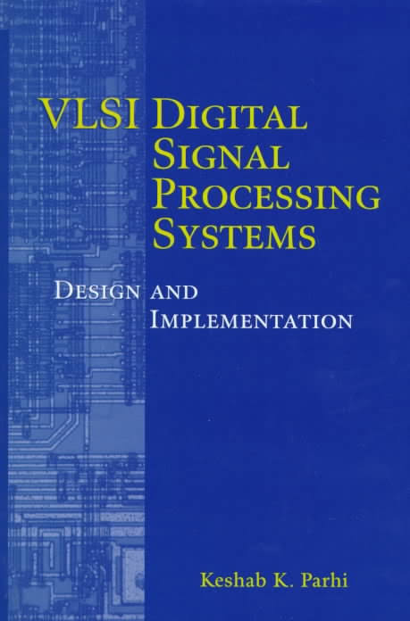

Sách tham khảo

Slide 3

Phần mềm

Slide 4

Phần mềm

Slide 5
Topics
Introduction
Digital circuit design with Verilog
Iteration Bound
Pipelining and Parallel Processing
Retiming
Unfolding
Folding
Systolic Architecture Design
Algorithmic Strength Reduction in Filters and Transforms
Bit-Level Arithmetic Architectures

Slide 6
Nội dung
Giới thiệu nội dung môn học
Tổng quan
Phương pháp luận thiết kế
FPGA (Field-Programmable Gate Array)
HDL
Tự đọc thêm
trong slide bài giảng

Slide 7
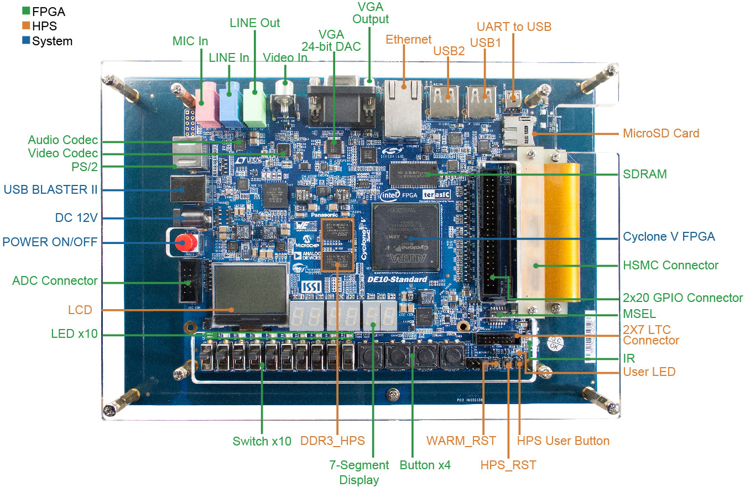
DE10 Standard Development Kit

Slide 8
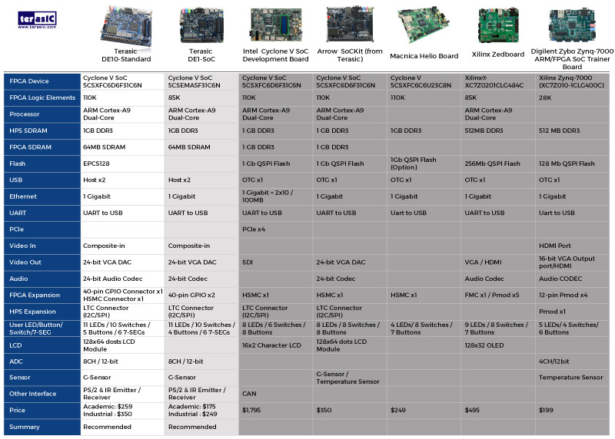
Board Comparisons

Slide 9
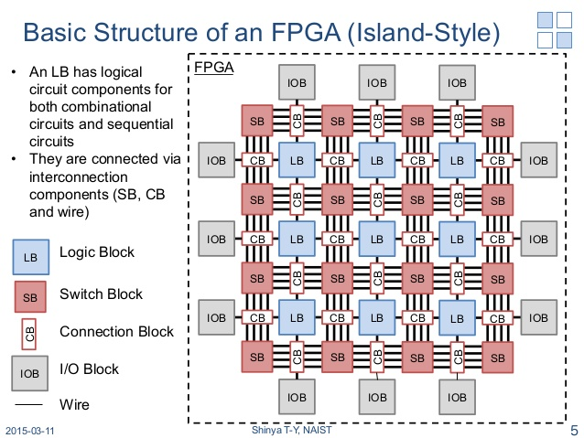
FPGA internal structure
(or CLB)

Slide 10
FPGA internal structure
(or CLB)
in1
in2
out

Slide 11
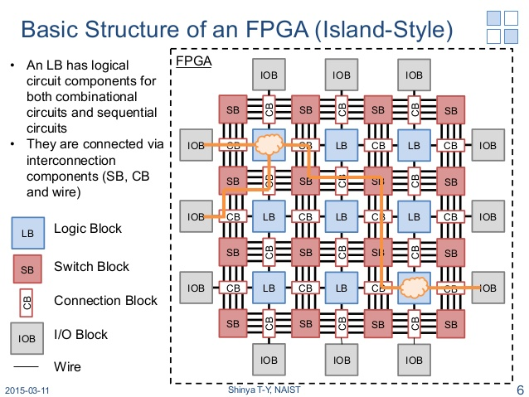
FPGA internal structure
(or CLB)
in1
in2
out

Slide 12
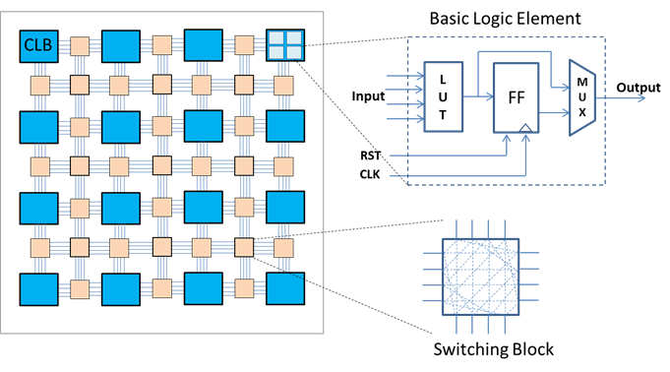
FPGA internal structure
(SB)
A state-of-the-art FPGA contains thousands of configurable logic blocks (CLBs)
Each CLB will have several basic logic elements (LE) consisting of a look-up table (LUT) for implementing combinational logic and a memory element known as a flip-flop (FF)
The wires connecting the various CLBs can be programmed as well through a series of switching boxes (SB) in the routing channels
A high-level description language such as VHDL or Verilog is used to describe how an FPGA is to be configured.

Slide 13
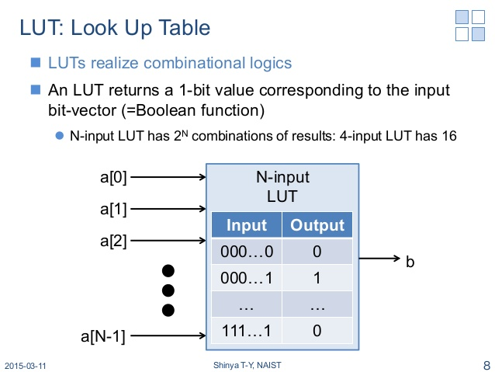
FPGA internal structure

Slide 14
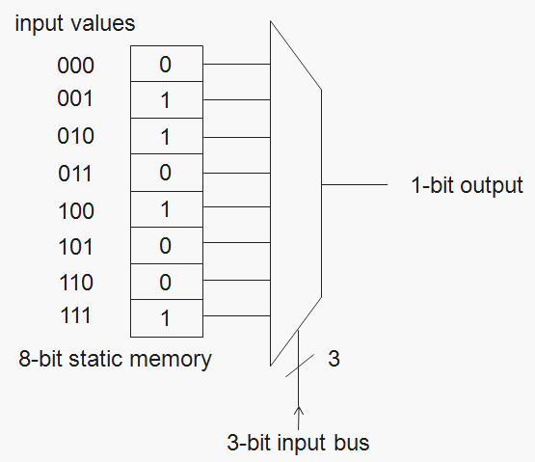
Look Up Table (LUT)
A look up table is basically a binary truth table.
It has a set of input bits, and the LUT mechanism maps these to a set of output bits.
e.g. F(010₂) = 1₂
F
Any guess as to what Boolean function this LUT is configured for?

Slide 15
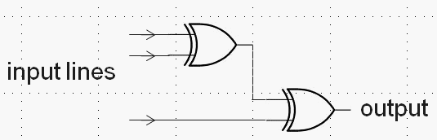
Look Up Table (LUT)
A look up table is basically a binary truth table.
It has a set of input bits, and the LUT mechanism maps these to a set of output bits.
e.g. F(010₂) = 1₂
F
ANSWER: It’s simply an XOR of all the inputs

Slide 16
Programmable Interconnect to CLB I/O as: LUT or MUXes
Programming lines
CLB
A
Inputs
B
LUT
or
MUX
C
CLB
D
. . .
A
B
LUT
or
MUX
Hopefully you can now easily see how the programming is going to happen…
C
D

Slide 17
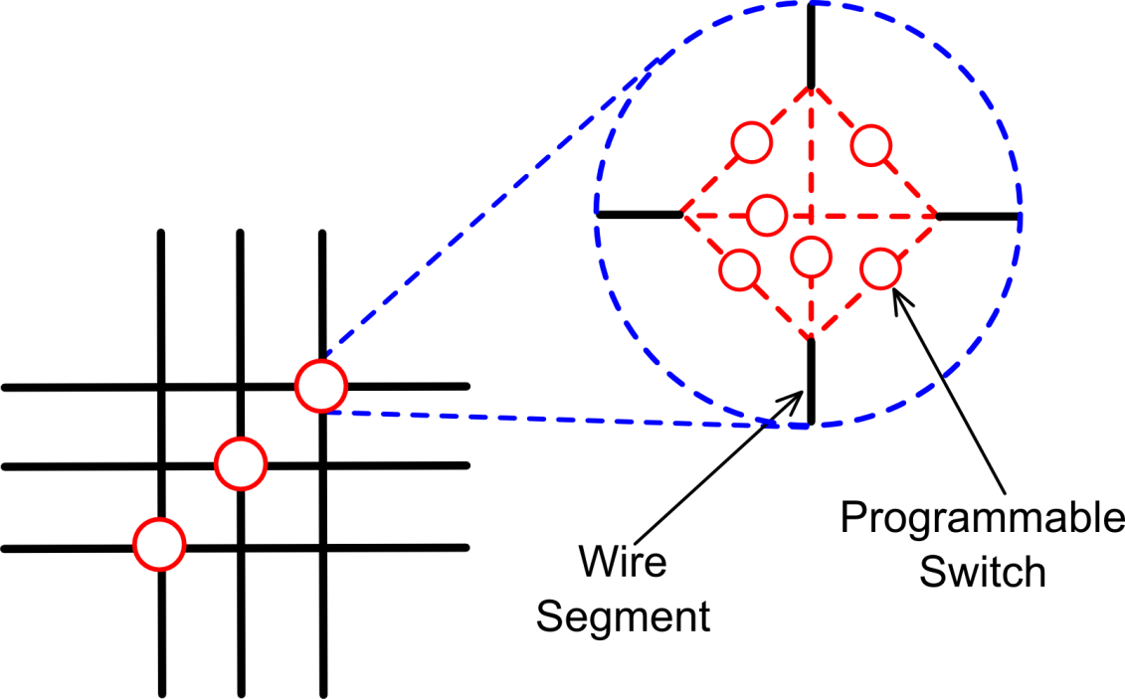
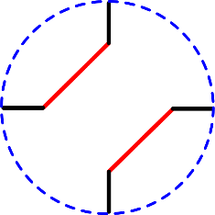
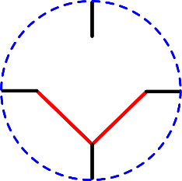
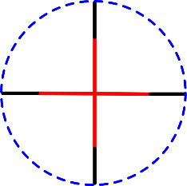
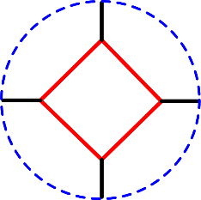
Programmable Interconnect: Switch Blocks
CLB
The switch block is an efficient particularly for implementing the routing at junctions in between PLBs, it allows for various configurations that the comparatively simpler multiplexer doesn’t provide*.
Example Switch Block configurations:
left-top ,
right-bottom
Bottom- (right,left)
bottom-top , right-left
all
* Although of course multiple MUXes could mimic this behaviour.

Slide 18
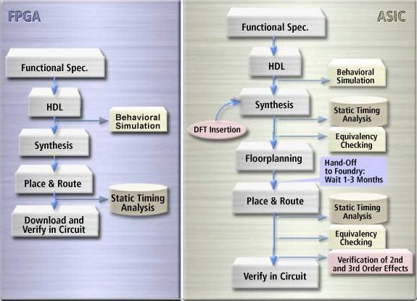
ASIC/FPGA Design Flow

Slide 19
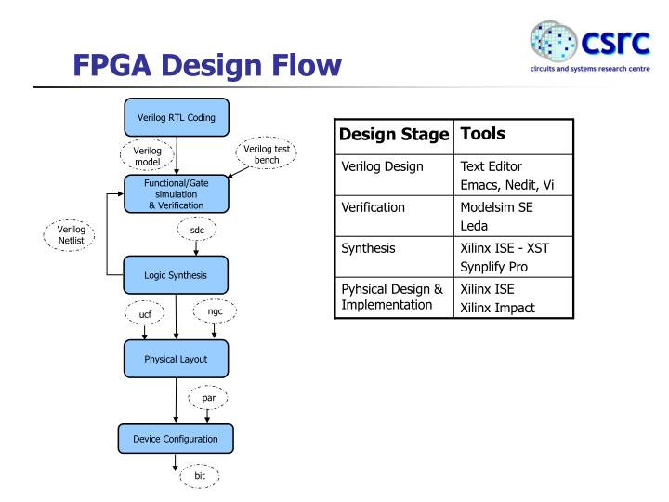

Slide 20
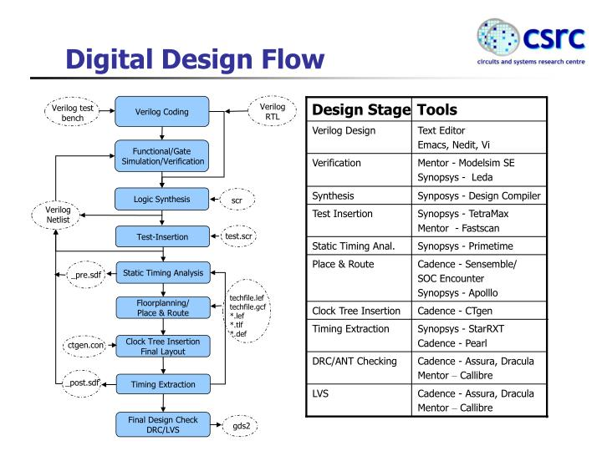

Slide 21
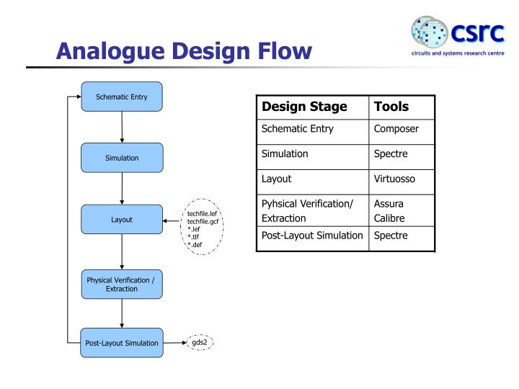

Slide 22
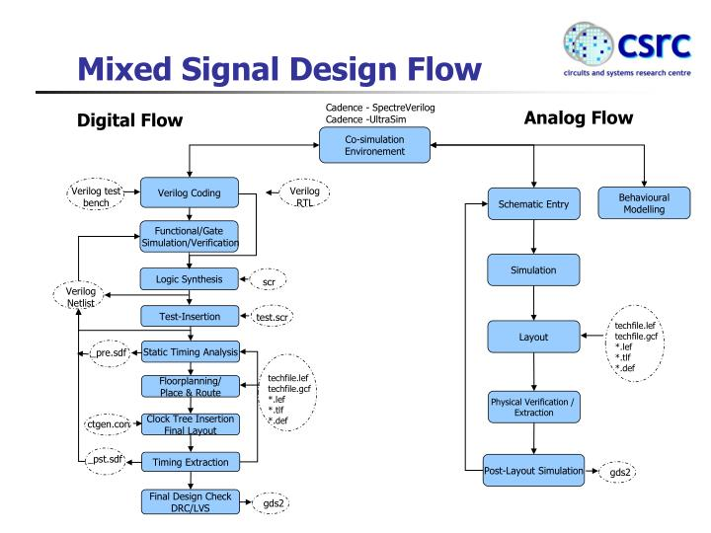

Slide 23
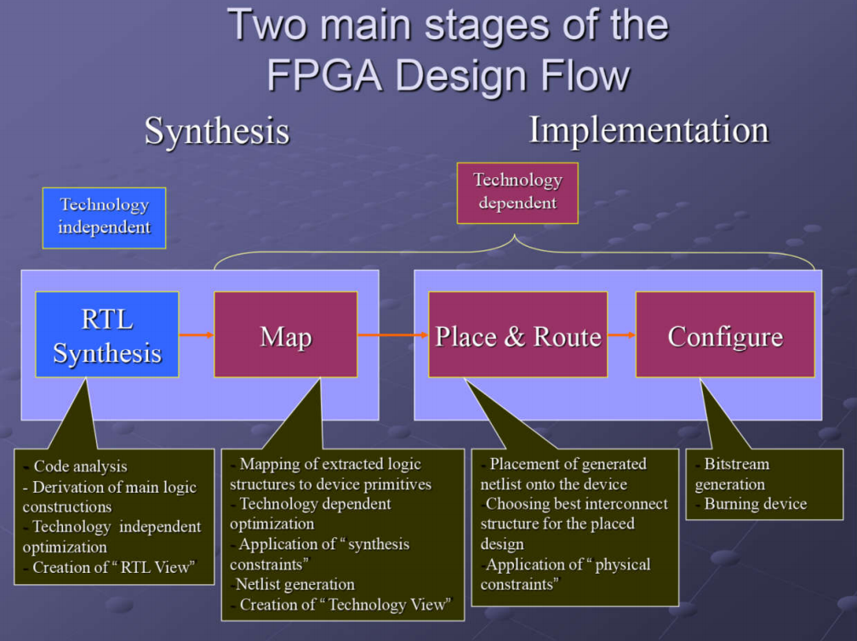
FPGA Design Flow

Slide 24
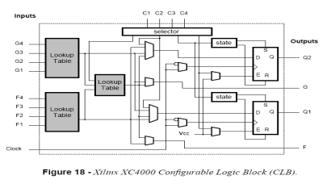
FPGA Design Flow
Design Specification
Design and RTL Coding
- Behavioral or Structural Description of Design - Writing VHDL (or Verilog), deciding i/o, formulating tests
RTL Simulation
- Functional Simulation
- Verify Logic Model & Data Flow
- View model-specified timing
LE
M512
Synthesis
- Translate Design into Device Specific Primitives
- Optimization to Meet Required Area & Performance Constraints
M4K
I/O
Place and Route (PAR)
- Map primitives to specific locations inside FPGA with reference to area & performance constraints
- Specify routing resources to use
……

Slide 25
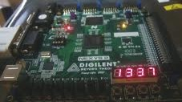
FPGA Design Flow
Place and Route (PAR)
t_{clk}
Timing Analysis
- Verify performance specifications
- Static timing analysis
Gate Level Simulation
- Timing simulation
- Verify design will work on target platform
Program and test on hardware
- Generate bit file - Program target device
- Activate the system

Slide 26
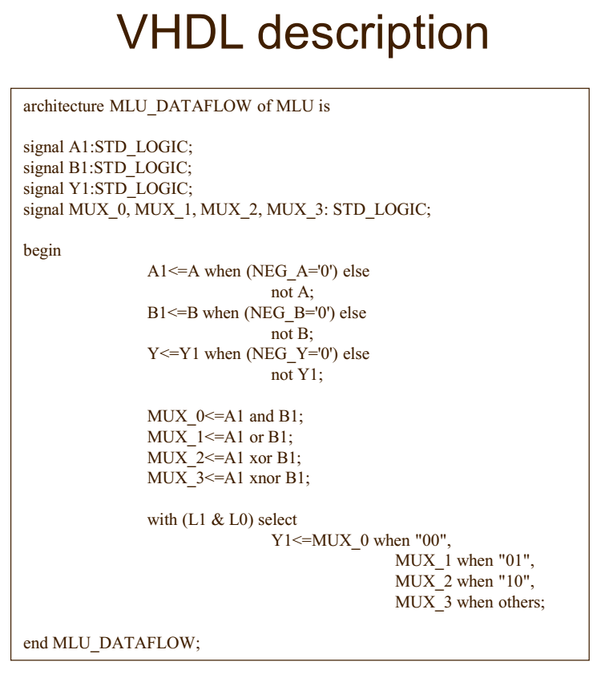
FPGA Design Flow - HDL description

Slide 27
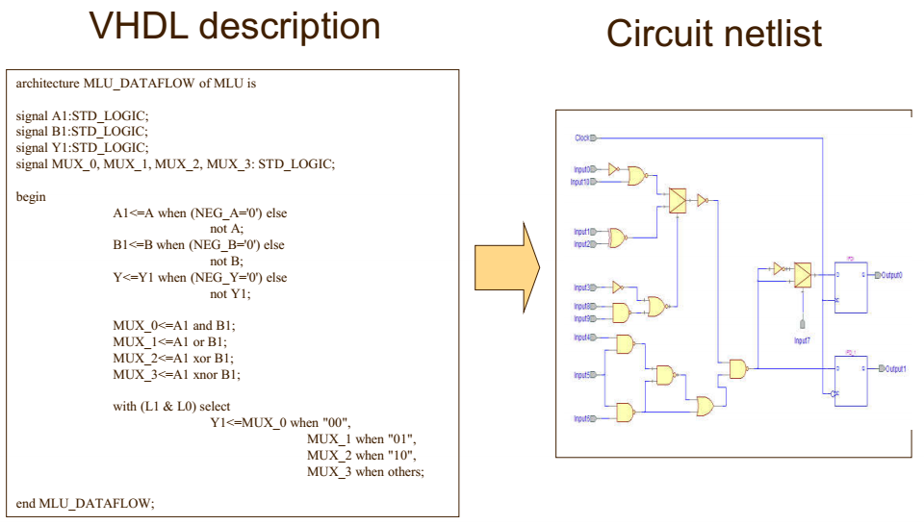
FPGA Design Flow – Logic Synthesis
(Register Transfer Level (RTL) view)
https://www.semiconvn.com/home/hoc-thiet-ke-vi-mach/bai-hc-vi-mch/8192-quy-trinh-thiet-ke-fpga-tong-quat.html

Slide 28
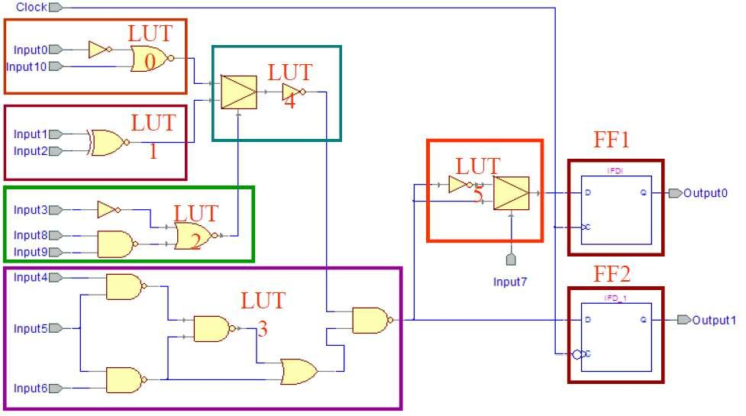
FPGA Design Flow - Mapping

Slide 29
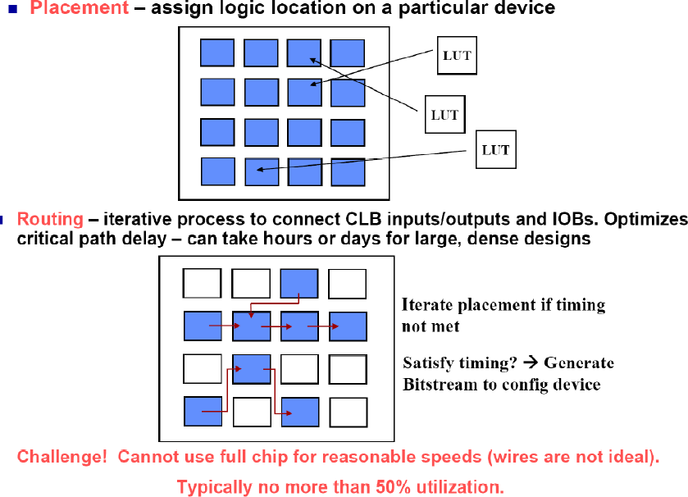
FPGA Design Flow - Place & Route
CLB
CLB
CLB
CLB
CLB
CLB
CLB
CLB
CLB
CLB
CLB
CLB
CLB
CLB
CLB
CLB

Slide 30
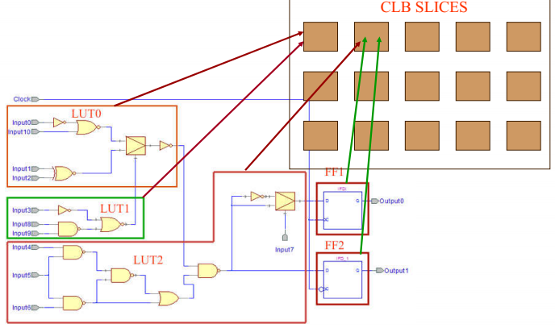
FPGA Design Flow - Placement

Slide 31
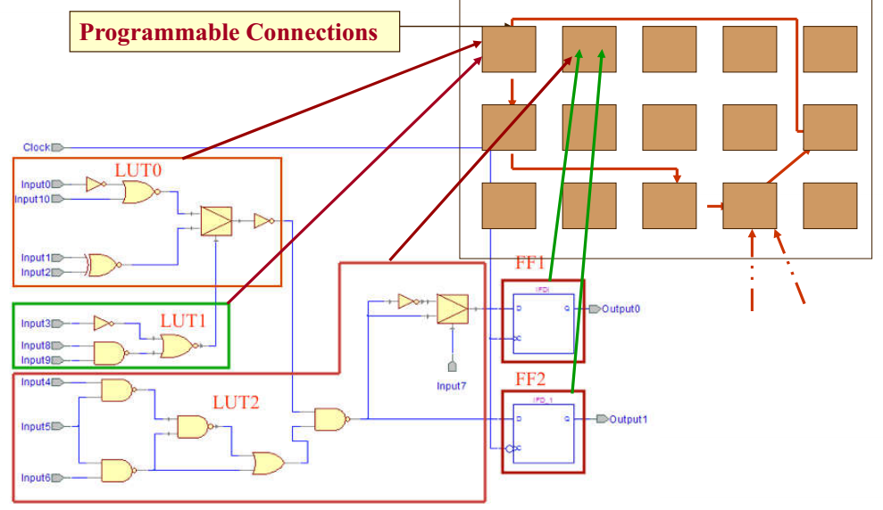
FPGA Design Flow - Routing

Slide 32
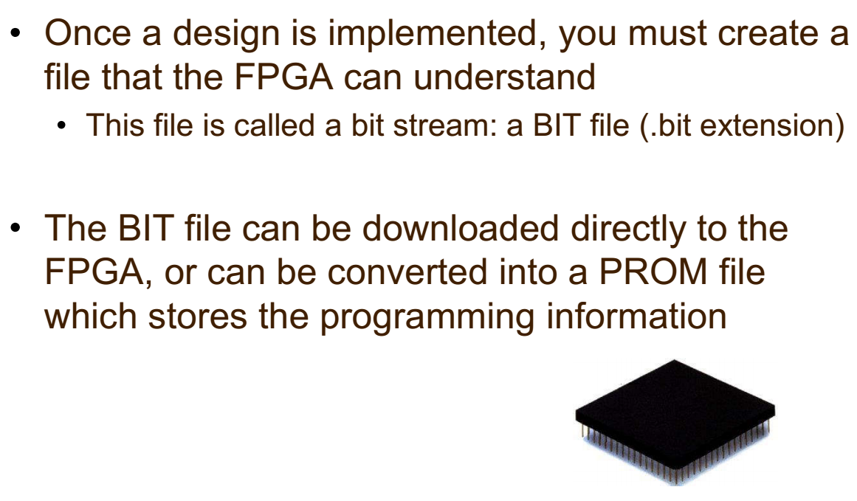
FPGA Design Flow - Configuration
FPGA

Slide 33




FPGA Design Flow: Where is most time spent?
Every development project is different. In my own experience, most of the time is probably spent…
Eish!
Design and RTL Coding
- Behavioral or Structural Description of Design - Writing HDL, deciding i/o, formulating tests
t_{clk}
Timing Analysis
- Verify performance specifications
- Static timing analysis
Engineer’s time
Eish!
Place and Route (PAR)
- Map primitives inside FPGA
- Specify routing resources to use
PC’s time

Slide 34
Performance Metrics of a Digital Chip
Cost
NRE (fixed) costs - design effort
RE (variable) costs - cost of parts, assembly, test
Speed
Delay (ns)
Power Dissipation
Energy to Perform a Function
Energy per bit (nJ/b)
Reliability
Noise immunity Noise margin
Scalability Larger Designs
Time-to-Market
Non-recurring engineering (NRE) = Kỹ thuật không định kỳ (NRE) đề cập đến chi phí một lần
để nghiên cứu, thiết kế, phát triển và thử nghiệm một sản phẩm mới hoặc cải tiến sản phẩm.

